Slide 1
GPU
Prepared by Gireesha

Slide 2
GPU vs CPU
A GPU is tailored for highly parallel operation while a CPU executes programs serially
For this reason, GPUs have many parallel execution units and higher transistor counts, while CPUs have few execution units and higher clockspeeds
A GPU is for the most part deterministic in its operation (though this is quickly changing)
GPUs have much deeper pipelines (several thousand stages vs 10-20 for CPUs)
GPUs have significantly faster and more advanced memory interfaces as they need to shift around a lot more data than CPUs

Slide 3
The GPU pipeline
The GPU receives geometry information from the CPU as an input and provides a picture as an output
Let’s see how that happens
host
interface
vertex
processing
triangle
setup
pixel
processing
memory
interface

Slide 4
Host Interface
The host interface is the communication bridge between the CPU and the GPU
It receives commands from the CPU and also pulls geometry information from system memory
It outputs a stream of vertices in object space with all their associated information (normals, texture coordinates, per vertex color etc)
host
interface
vertex
processing
triangle
setup
pixel
processing
memory
interface

Slide 5
Vertex Processing
The vertex processing stage receives vertices from the host interface in object space and outputs them in screen space
This may be a simple linear transformation, or a complex operation involving morphing effects
Normals, texcoords etc are also transformed
No new vertices are created in this stage, and no vertices are discarded (input/output has 1:1 mapping)
host
interface
vertex
processing
triangle
setup
pixel
processing
memory
interface

Slide 6
Triangle setup
In this stage geometry information becomes raster information (screen space geometry is the input, pixels are the output)
Prior to rasterization, triangles that are backfacing or are located outside the viewing frustrum are rejected
Some GPUs also do some hidden surface removal at this stage
host
interface
vertex
processing
triangle
setup
pixel
processing
memory
interface

Slide 7
Fragment Processing
Each fragment provided by triangle setup is fed into fragment processing as a set of attributes (position, normal, texcoord etc), which are used to compute the final color for this pixel
The computations taking place here include texture mapping and math operations
Typically the bottleneck in modern applications
host
interface
vertex
processing
triangle
setup
pixel
processing
memory
interface

Slide 8
Memory Interface
Fragment colors provided by the previous stage are written to the framebuffer
Used to be the biggest bottleneck before fragment processing took over
Before the final write occurs, some fragments are rejected by the zbuffer, stencil and alpha tests
On modern GPUs, z and color are compressed to reduce framebuffer bandwidth (but not size)
host
interface
vertex
processing
triangle
setup
pixel
processing
memory
interface

Slide 9
Programmability in the GPU
Vertex and fragment processing, and now triangle set-up, are programmable
The programmer can write programs that are executed for every vertex as well as for every fragment
This allows fully customizable geometry and shading effects that go well beyond the generic look and feel of older 3D applications
host
interface
vertex
processing
triangle
setup
pixel
processing
memory
interface

Slide 10
CPU/GPU interaction
The CPU and GPU inside the PC work in parallel with each other
There are two “threads” going on, one for the CPU and one for the GPU, which communicate through a command buffer:
GPU reads commands from here
Pending GPU commands
CPU writes commands here

Slide 11
CPU/GPU interaction (cont)
If this command buffer is drained empty, we are CPU limited and the GPU will spin around waiting for new input.
If the command buffer fills up, the CPU will spin around waiting for the GPU to consume it, and we are effectively GPU limited

Slide 12
CPU/GPU interaction (cont)
Another important point to consider is that programs that use the GPU do not follow the traditional sequential execution model
In the CPU program below, the object is not drawn after statement A and before statement B:
Instead, all the API call does, is to add the command to draw the object to the GPU command buffer
Statement A
API call to draw object
Statement B

Slide 13
Synchronization issues
This leads to a number of synchronization considerations
In the figure below, the CPU must not overwrite the data in the “yellow” block until the GPU is done with the “black” command, which references that data:
GPU reads commands from here
CPU writes commands here
data

Slide 14
GPU readbacks
The output of a GPU is a rendered image on the screen, what will happen if the CPU tries to read it?
The GPU must be syncronized with the CPU, ie it must drain its entire command buffer, and the CPU must wait while this happens
GPU reads commands from here
Pending GPU commands
CPU writes commands here

Slide 15
GPU readbacks (cont)
We lose all parallelism, since first the CPU waits for the GPU, then the GPU waits for the CPU (because the command buffer has been drained)
Both CPU and GPU performance take a nosedive
Bottom line: the image the GPU produces is for your eyes, not for the CPU (treat the CPU -> GPU highway as a one way street)

Slide 16
Some more GPU tips
Since the GPU is highly parallel and deeply pipelined, try to dispatch large batches with each drawing call
Sending just one triangle at a time will not occupy all of the GPU’s several vertex/pixel processors, nor will it fill its deep pipelines
Since all GPUs today use the zbuffer algorithm to do hidden surface removal, rendering objects front-to-back is faster than back-to-front (painters algorithm), or random ordering
Of course, there is no point in front-to-back sorting if you are already CPU limited

Slide 17
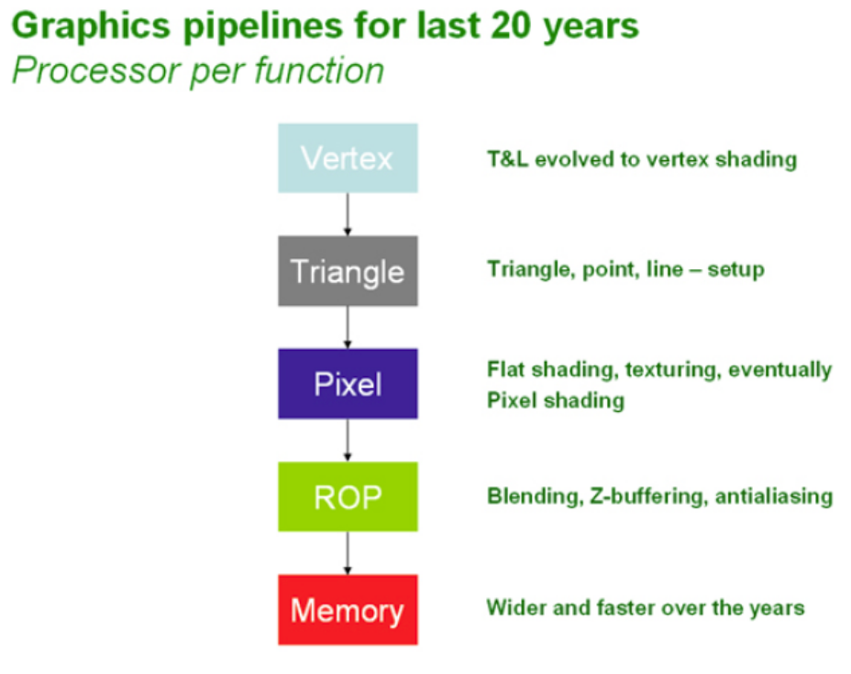
Graphics Hardware Abstraction
OpenGL and DirectX provide an abstraction of the hardware.

Slide 18
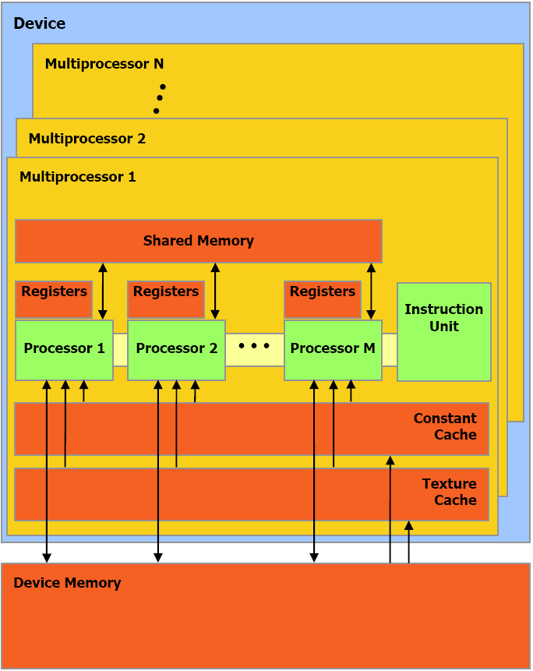
nVidia G80 GPU Architecture Overview
16 Multiprocessors Blocks
Each MP Block Has:
  8 Streaming Processors
  16K Shared Memory
  64K Constant Cache
  8K Texture Cache
Each processor can access all of the memory at 86Gb/s, but with different latencies:
Shared – 2 cycle latency
Device – 300 cycle latency

